Slide 1



Measuring the Quality of a Childhood Cancer Care Delivery System: Development and Operationalizing a Framework and Quality Indicators
3rd Pediatric Cancer Forum
Rio de Janeiro August 27, 2015
Dr. Mark Greenberg Senior Adviser, Policy & Clinical Affairs, POGO
Professor of Paediatrics and Surgery, University of Toronto
On Behalf of the Pediatric Oncology QI Investigator Group

Slide 2
Outline
Why do this anyway?
Phase I – Quality Assessment Frameworks
Phase II – Quality Indicator Development & Framework Selection
Phase III – Stakeholder Feedback: Modified Delphi Panel Process
Next Steps & Implementation

Slide 3

Centuries of Bloodletting for the Cure
How do we know we are doing a good job?

Slide 4


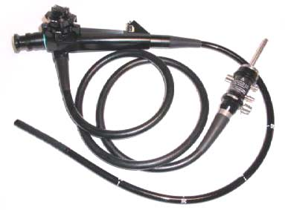
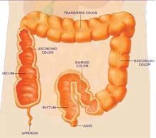

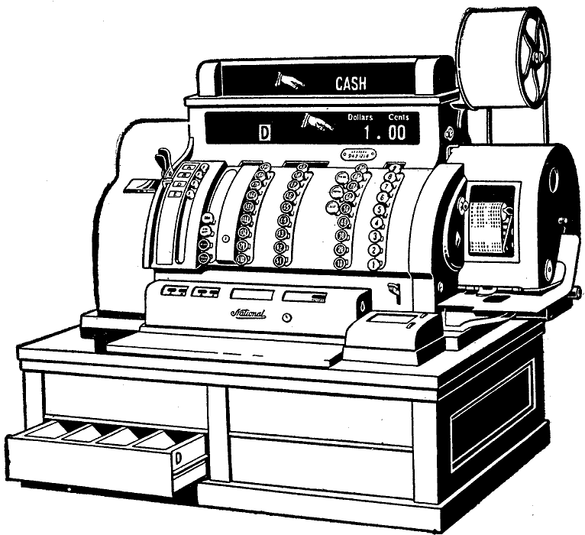
Which Lenses are Necessary?
Patient outcomes?
Different phases of the cancer journey?
Nursing?
All!
System?
Notes:
Fly in one at a time: System? Different phases of the cancer journey? Patient Outcomes? Nursing? Nutrition? All!

Slide 5

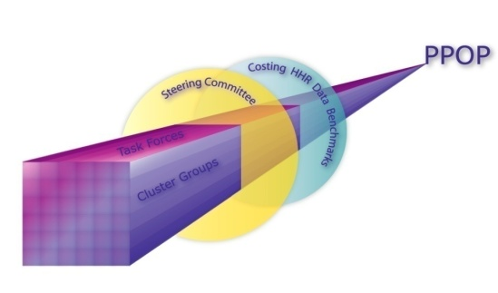
What Enabled the POGO Initiative?
1. Well integrated provincial cancer delivery & control system
2. Enduring, evidence based, collegial partnership of treating hospitals
3. POGONIS - Networked Information System and ability to link to other
Databases )
Tertiary Centres
Satellite Centres
AfterCare Programs
CH, LHSC
SRH
CHEO.5
WRH
SickKids
OSMH
TORCC
General Profiles
Demographics – Patient/ Family
Sociographics – Patient/ Family
MCH, HHS
CH, LHSC
CHEO
SRHC
Disease Characteristics
Diagnosis & Stage
Status
Death Record
GRH
MCH, HHS
KGH
Status Markers
SickKids
RVC
KGH
Medical Treatments
Type, Date and Details
Locus of Treatment
POGO Centres
Satellite Programs
Late Effects
CVH
PMH
Allied Health Treatments
POGO Centres
Satellite Programs
Health Service Utilization Data
4. Evidence- & consensus-based long range childhood cancer plan
5. Government Accountabilty
in a single payer Health Care System
Notes:
4. PPOP - Preliminary research done by the Outcomes Working Group charged by POGO with the responsibility for identifying strategies to develop quality indicators (part of the Provincial Pediatric Oncology Plan)

Slide 6
Objectives
To develop a set of quality indicators for a childhood cancer system – ours and others (none existed)
To select quality indicators that would:
take the pulse of the system (regular and irregular?)
identify actionable issues
achieve buy-in from the childhood cancer stakeholder community
To set the indicators within a balanced framework
To deliver on POGO commitments to system accountability and quality through accurate measurement
Notes:
These indicators will be used to track dimensions of the childhood cancer system in Ontario in a standardized manner.

Slide 7
Intended Use and Target Audience
Intended Use of Quality Indicator Set
review of the functioning of the system using prospective, standardized data
continuous quality improvement and self-regulation – local and provincial
benchmarking – national and international
public reporting – accessible, standardized, timely, useful
not intended to evaluate individual health provider performance
Target Stakeholder Group
healthcare providers
hospital administrators/managers/institutions
parents, families and survivors
researchers
Provincial Ministry of Health and Long-Term Care (MOHLTC)/policymakers/ other funders

Slide 8

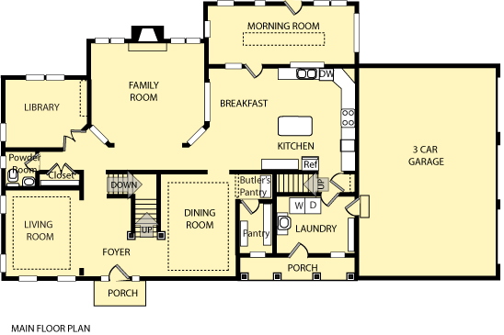
Relationship of Frameworks and Indicators

Slide 9
Outline
Why do this anyway?
Phase I – Quality Assessment Frameworks
Phase II – Quality Indicator Development & Framework Selection
Phase III – Stakeholder Feedback: Modified Delphi Panel Process
Next Steps & Implementation

Slide 10
Stages of Study Development
Phase I Framework Review
Review of Quality Assessment Frameworks (Comprehensive Systematic Review of Frameworks) (Klassen, et al, 2010)
Notes:
First phase of this initiative, which involved a review of quality assessment frameworks

Slide 11
Review of Quality Assessment Frameworks
Recent comprehensive, large-scale systematic review of quality frameworks in health, education and social service sectors¹ identified:
>25,000 citations reviewed
111 frameworks identified
NONE WERE SPECIFIC TO CHILDHOOD CANCER or APPLICABLE
¹ Klassen A, Miller A, Anderson N, Shen J, Schiariti V, O’Donnell M. Performance measurement and improvement frameworks in health, education and social services systems: a systematic review. Int J Qual Health Care, 2010;22(1):44-69.
Notes:
These frameworks were identified through a recent, large, comprehensive systematic review conducted by Dr. Anne Klassen and colleagues of quality frameworks in the health, education and social service sectors
Over 25,000 citations were reviewed
Total of 111 frameworks were identified, varying in complexity and developed for different purposes, sectors, settings and populations.
Most frameworks were developed based on pre-existing frameworks or approaches to quality improvement and the majority were developed in or for the health sector.
Although 14 pediatric-specific frameworks were identified, none were specific to childhood cancer
A concept sorting exercise was then performed and 16 common quality concept areas were identified through this exercise that are applicable to many settings and sectors.

Slide 12
Outline
Why do this anyway?
Phase I – Quality Assessment Frameworks
Phase II – Quality Indicator Development & Framework Selection
Phase III – Stakeholder Feedback: Modified Delphi Panel Process
Next Steps & Implementation

Slide 13
Stages of Study Development
Phase I Framework Review
Review of Quality Assessment Frameworks (Comprehensive Systematic Review of Frameworks) (Klassen, et al, 2010)
Phase II Indicator Development & Framework Selection
Review of Published Quality Indicators relevant to Childhood Cancer (Systematic Review and Targeted Grey Literature Search)
Notes:
2nd phase of this initiative, involved the indicator development and framework selection phase
The first step in developing the indicators was to review the published literature for pediatric-oncology specific quality indicators

Slide 14
Quality Indicators – Review, Development, Selection
Systematic Review Results
Total Unique Citations (Medline and Embase) (n=845)
Related to Quality of Care (Title/ Abstract Review) (n=155)
Related to Quality of Pediatric Oncology Care (Title/ Abstract Review) (n=33)
Related to Topic of Quality Measures/ Indicators (Full-Text Screen) (n=12)
None were considered to define priority indicators
Total Included Studies
(n=4)
Notes:
- A systematic review was conducted using Medline and Embase for studies published over a 15-year period, from 1996 to 2010
Studies were included if they specifically suggested at least one quality indicator of a childhood cancer system
A total of 845 unique citations were identified
Only 4 studies were identified that met our inclusion criteria.

Slide 15
Stages of Study Development
Phase I Framework Review
Review of Quality Assessment Frameworks (Comprehensive Systematic Review of Frameworks) (Klassen, et al, 2010)
Phase II Indicator Development & Framework Selection
Review of Published Quality Indicators relevant to Childhood Cancer (Systematic Review and Targeted Grey Literature Search)
Development of Provisional Set of Pediatric Oncology System Quality Indicators (Investigator Focus Group Sessions)

Slide 16
Quality Indicators – Review, Development, Selection Investigator Focus Group Sessions
Indicators considered should:
span the journey of the child through the continuum of care
add value, e.g.:
enhancing/affirming level of functioning of delivery system (e.g. Drug Availability)
yield new/actionable information
have known or readily available benchmarks (e.g. Five-Year Overall Survival)
be identified as applicable to other jurisdictions or specific to Ontario
have data that are feasible to collect (currently or in the future)
Notes:
A variety of key considerations were used by the group during the indicator development process.
First, indicators should track the journey of the child through the cancer trajectory
Another key consideration was that indicators should add value and enhance or affirm the level of functioning of the childhood cancer delivery system. E.g. the Drug Availability indicator, which measures access to essential pediatric oncology drugs through the Exceptional Access Program in Ontario).
Indicators should also optimize the child’s journey through the cancer trajectory (e.g., indicator on the use of Supportive Care Guidelines).
Feasibility of data collection was also a key consideration during the indicator development process. Sources of data were ascertained for each draft indicator, including whether data collection is already established through POGONIS, administrative databases or at the hospital level) or whether new and standardized data collection processes would need to be created.
The ease of data retrieval and collection was also considered, however, indicators that were felt to be important measures of the quality of the system which did not have data collection presently established were not excluded on this basis.
The availability of known or readily available benchmarks were also considered, including national or international comparisons wherever available. (Example: an indicator of five-year overall relative survival)
Indicators were also identified as being applicable to other jurisdictions or specific to Ontario
Indicator definitions were drafted.

Slide 17
Quality Indicators – Review, Development, Selection Investigator Focus Group Sessions
Investigator focus group sessions
over an 18-month period
created 120 provisional quality indicators through:
discussion of indicators and concepts identified by the systematic review and grey literature search
brainstorming of additional indicators using the 16 common quality concept areas
Notes:
A series of Investigator Focus Group sessions were held over an 18-month period, which resulted in the creation of 120 draft quality indicators for the childhood cancer system.
Our investigator group consisted of high-level decision makers, highly experienced content experts, as well as methodologists
These draft indicators were developed based on discussion of the potentially relevant indicators and concepts identified by the systematic review and grey literature search, as well as active discussion and brainstorming of additional indicators.
At this phase, the original intent was to encompass the 16 common quality concept areas identified in the Klassen systematic review.

Slide 18
120 Provisional Quality Indicators by Common Quality Concept Areas¹
Access/ Availability (n=52)
Patient Safety (n=14)
Quality Improvement Processes (n=14)
Coordination/ Collaboration² (n=13)
Creating & Using Knowledge (n=13)
Infrastructural Capacity (n=11)
Leadership/ Governance (n=10)
Effectiveness (n=7)
Appropriateness (n=6)
Equity/ Fairness (n=6)
Workforce Development (n=6 )
Financial Management (n=5)
Family-Centred³ (n=2)
Comprehensiveness (n=1)
Patient/ Family Perspective⁴ (n=1)
¹ Klassen A, Miller A, Anderson N, Shen J, Schiariti V, O’Donnell M. Performance measurement and improvement frameworks in health, education and social services systems: a systematic review. Int J Qual Health Care, 2010;22(1):44-69
² The original two domains of the 16 common quality concept areas, “coordination” and “collaboration” were merged into one
² The domain of “family-centred” was adapted from the original “client centredness”
³ The domain of ‘patient/family satisfaction” was adopted from the original “client perspective”
Notes:
The most frequent quality domains were “Access and Availability (with 43% of indicators), followed by “Patient Safety” and “Quality improvement processes (both with 14 QIs (12% of indicators), “Collaboration and Coordination” and “Creating and Using Knowledge” (both with 13 indicators (11% of indicators).
Furthermore, there were seven provisional indicators developed related to effectiveness and patient outcomes

Slide 19
Stages of Study Development
Phase I Framework Review
Review of Quality Assessment Frameworks (Comprehensive Systematic Review of Quality Assessment Frameworks) (Klassen, et al, 2010)
Phase II Indicator Development & Framework Selection
Review of Published Quality Indicators relevant to Childhood Cancer (Systematic Review and Targeted Grey Literature Search)
Development of Provisional Set of Pediatric Oncology System Quality Indicators (Investigator Focus Group Sessions)
Evaluation & Selection of a Subset of Indicators based on Sequential Selection Criteria (Indicator Evaluation by Content Experts of the Investigator Group)

Slide 20
Quality Indicators – Review, Development, Selection Evaluation of Provisional Quality Indicators
120 provisional quality indicators independently evaluated:
by three content experts
in a sequential selection process, based on a series of selection criteria:
Preliminary ‘Quick Screen’ Selection Criteria
(must fulfill all 4 criteria)
overall importance
relevance at the system level
alignment with system-level mission statement
alignment with ≥1 system-level strategic objectives
Preliminary ‘Quick Screen’ Selection Criteria
(n=120 quality indicators)
Notes:
120 draft quality indicators were independently evaluated by three content experts of the investigator group in a sequential selection process in order to select a subset of indicators to be considered by the stakeholder community in the Delphi Panel process (Phase III)
The evaluation was based on a series of criteria:
First, the 120 draft indicators were evaluated using set of four Preliminary ‘Queen Screen’ Criteria, which included overall importance, alignment with system-level mission statement and at least one strategic objective, and relevance at capturing quality at the level of the system
In order to move forward, indicators must fulfill all four criteria from the quick screen phase.
89 indicators met the quick screen criteria, and were subsequently evaluated using the ‘primary selection criteria.
These criteria were scored on a 4-point likert scale and included face validity, relevance to capturing quality at the level of the system, clear directionality, applicability to priority considerations (i.e. high-volume, high-risk and high-needs issues), and the ability to address at least one target stakeholder group (i.e. patient/family/ survivor, MOHLTC or health care providers)

Slide 21
Quality Indicators – Review, Development, Selection Evaluation of Provisional Quality Indicators
120 provisional quality indicators independently evaluated:
by three content experts
in a sequential selection process, based on a series of selection criteria:
Primary Selection Criteria (scored on 4-point Likert scale)
face validity
relevance to quality improvement
relevance to healthcare accountability
relevance to identifying important gaps
directionality & interpretability
addresses a priority area (i.e. high-volume, high-risk, high-needs issue)
addresses ≥ 1 target stakeholder group
Preliminary ‘Quick Screen’ Selection Criteria
(n=120 quality indicators)
Primary Selection Criteria
(n=89 quality indicators)
Notes:
120 draft quality indicators were independently evaluated by three content experts of the investigator group in a sequential selection process in order to select a subset of indicators to be considered by the stakeholder community in the Delphi Panel process (Phase III)
The evaluation was based on a series of criteria:
First, the 120 draft indicators were evaluated using set of four Preliminary ‘Queen Screen’ Criteria, which included overall importance, alignment with system-level mission statement and at least one strategic objective, and relevance at capturing quality at the level of the system
In order to move forward, indicators must fulfill all four criteria from the quick screen phase.
89 indicators met the quick screen criteria, and were subsequently evaluated using the ‘primary selection criteria.
These criteria were scored on a 4-point likert scale and included scientific soundness and face validity, relevance to capturing quality at the level of the system, relevance to healthcare accountability, clear directionality, applicability to priority considerations (i.e. high-volume, high-risk and high-needs issues), and the ability to address at least one target stakeholder group (i.e. patient/family/ survivor, MOHLTC or health care providers)

Slide 22
Quality Indicators – Review, Development, Selection Evaluation of Provisional Quality Indicators
120 provisional quality indicators independently evaluated:
by three content experts
in a sequential selection process, based on a series of selection criteria:
Preliminary ‘Quick Screen’ Selection Criteria
(n=120 quality indicators)
Selection of Subset of QIs for Stakeholder Feedback
Analysis of median indicator scores
Indicators rank ordered on median scores, and reduced to 33 indicators for Delphi panel consideration.
Primary Selection Criteria
(n=89 quality indicators)
Selection of Subset of Indicators for Delphi Panel Consideration
(n=33 quality indicators)
Notes:
Based on an analysis of the median respondent scores (on the primary selection criteria), indicators were rank ordered on median scores and discussed by the three content experts to obtain a list of 33 indicators for Delphi panel consideration.

Slide 23
Quality Indicators – Review, Development, Selection Why Did Investigators Exclude Provisional Quality Indicators?
Reasons for Exclusion of Provisional Indicators | Provisional Quality Indicator Examples
Better suited as a research study | Health-Related Quality of Life Cost Analysis of Fever Neutropenia Treatment in Ambulatory vs. Inpatient Setting
Lack of consensus about acceptable standard | Access to Social Work/ Neuropsychology (i.e. wait time definition)
Notes:
What were some reasons why the content experts excluded some indicators?
- Some draft indicators did not lend themselves for evaluation as a quality indicator in a continuous quality measurement set, e.g. .
although HRQL was identified as an important concept in assessing the quality of the childhood cancer system, it was felt that the assessment would need to be stratified according to various sub-patient populations for interpretation and therefore would be better suited for study in a research study.
Similarly, a draft indicator examining a cost-analysis of treating F/N in ambulatory vs. inpt setting was also felt to be better suited to study as a rsch initiative due to the challenges in developing cost-effectiveness methodology for purposes of quality measurement
Furthermore, some indicators were excluded due to the lack of evidence for or consensus of a standard, e.g.
Although access to social work or neuropsychology were identified as important components of the system, there was no consensus across institutions in Ontario or identified evidence on the definition of an acceptable wait time at this time

Slide 24
33 Proposed Quality Indicators Span the Childhood Cancer Continuum of Care
Survivorship
(n=2)
Diagnosis
(n=5)
Treatment & Outcome
(n=26)
End-of-Life Care
(n=5)

Slide 25
Stages of Study Development
Phase I Framework Review
Review of Quality Assessment Frameworks (Comprehensive Systematic Review of Frameworks) (Klassen, et al, 2010)
Phase II Indicator Development & Framework Selection
Review of Published Quality Indicators relevant to Childhood Cancer (Systematic Review and Targeted Grey Literature Search)
Development of Provisional Set of Pediatric Oncology System Quality Indicators (Investigator Focus Group Sessions)
Evaluation & Selection of a Subset of Indicators based on Sequential Selection Criteria (Indicator Evaluation by Content Experts of the Investigator Group)
Further Indicator Definition & Specification (Investigator Focus Group Sessions)

Slide 26
Sample Proposed Quality Indicator Five-Year Overall Relative Survival
Indicator Definition: The proportion of pediatric oncology patients, 0 to 14 years of age, who survive five years or more after diagnosis, after adjusting for expected deaths from other causes
Indicator Specification: Proportion
Numerator: the total number of pediatric oncology patients, 0 to 14 years of age, diagnosed during the most recent five-year period, who survive five years or more after the date of diagnosis
Denominator: the total number of pediatric oncology patients, 0 to 14 years of age, diagnosed during the most recent five-year cohort, excluding expected deaths from non-cancer related causes
Indicator Rationale: five-year overall relative survival will provide a basic standardized measure of treatment efficacy for the Ontario childhood cancer population comparable to other published survival rates
Other Indicator Technical Specifications:
Source of Data: POGONIS
Levels of Analysis to be Reported:
Overall Provincial
By Tertiary Centre (for initial internal review at POGO Board, then consider broader reporting)
Sampling Timeframe: Most recent five-year cohort for which data is available in POGONIS (2009-20013 inclusive)
Interpretation of Score/Directionality: Better quality is associated with a higher overall relative survival proportion
Notes:
The subset of 33 proposed quality indicators to be proposed to the childhood cancer stakeholder community were then further defined and specified.
we further defined indicators and specified them as a proportion or rate (including the specific numerator and denominator).
For example, for the indicator “Five Year Overall Relative Survival”.....
The indicator rationale was recorded.
Other indicator technical specifications were also noted, including:
Proposed source of data
Levels of stratification/ analysis to be reported (e.g. provincially, by tertiary centre, by diagnostic group, by age group, etc).
Sampling timeframe (i.e. most recent five-year cohort, every 12 months, etc);
Interpretation of score/ directionality: e.g. better quality is associated with a higher overall relative survival rate.

Slide 27
Stages of Study Development
Phase I Framework Review
Review of Quality Assessment Frameworks (Comprehensive Systematic Review of Frameworks) (Klassen, et al, 2010)
Phase II Indicator Development & Framework Selection
Review of Published Quality Indicators relevant to Childhood Cancer (Systematic Review and Targeted Grey Literature Search)
Development of Provisional Set of Pediatric Oncology System Quality Indicators (Investigator Focus Group Sessions)
Evaluation & Selection of a Subset of Indicators based on Sequential Selection Criteria (Indicator Evaluation by Content Experts of the Investigator Group)
Further Indicator Definition & Specification (Investigator Focus Group Sessions)
Selection of a Quality Framework for the Childhood Cancer System (Investigator Focus Group)

Slide 28
Quality Dimensions of Cancer Care Ontario’s Cancer System Quality Index (CSQI)
Safe Avoiding, preventing, and ameliorating adverse outcomes or injuries caused by healthcare management. |  | Effective Providing services based on scientific knowledge to all who could benefit.
Responsive Providing care that is respectful of and responsive to individual patient preferences, needs, and values, and ensuring that patient values guide all clinical decisions. |  | Integrated Coordinating health services across the various functions, activities and operating units of a system.
Accessible Making health services available in the most suitable setting in a reasonable time and distance. | Equitable Providing care and ensuring health status does not vary in quality because of personal characteristics (gender, ethnicity, geographic location, SES). |  | Efficient Optimally using resources to achieve desired outcomes.
Notes:
The CSQI was thought to best reflected the key quality dimensions relevant to the pediatric oncology system and would also allow for comparability between the seven quality dimensions for Ontario’s pediatric and adult cancer systems.
The seven quality dimensions of the CSQI were originally adopted from the Institute of Medicine’s Committee on the Quality of Health Care in America.

Slide 29
Mapping of 33 Proposed Quality Indicators of the Childhood Cancer System by CSQI Quality Dimension
Safe (n=6) Avoiding, preventing, and ameliorating adverse outcomes or injuries caused by healthcare management. |  | Effective (n=7) Providing services based on scientific knowledge to all who could benefit.
Responsive (n=1) Providing care that is respectful of and responsive to individual patient preferences, needs, and values, and ensuring that patient values guide all clinical decisions. |  | Integrated (n=6) Coordinating health services across the various functions, activities and operating units of a system.
Accessible (n=8) Making health services available in the most suitable setting in a reasonable time and distance. | Equitable (n=4) Providing care and ensuring health status does not vary in quality because of personal characteristics (gender, ethnicity, geographic location, SES). |  | Efficient (n=10) Optimally using resources to achieve desired outcomes.
Notes:
We then mapped the 33 quality indicators onto the seven quality dimensions of the CSQI. Some indicators mapped onto more than one quality dimension
Examples:
† This indicator is also assigned to the Integrated, Equitable and Efficient quality domains. ‡ This indicator is also assigned to the Integrated and Efficient quality domains. § This indicator is also assigned to the Accessible, Equitable and Efficient quality domains.

Slide 30
Outline
Why do this anyway?
Phase I – Quality Assessment Frameworks
Phase II – Quality Indicator Development & Framework Selection
Phase III – Stakeholder Feedback: Modified Delphi Panel Process
Next Steps & Implementation

Slide 31
Assessing Stakeholder Agreement Modified Delphi Panel Composition
Selection Considerations
multidisciplinary, cross-centre, multi-sector, & opinion leaders across key stakeholder groups
panel size limited to 23 individuals to optimize desired group consensus process
Participation - five tertiary centres each:
nominated one ‘must have’ individual
recommended one individual per the following five disciplines for consideration:
Pediatric oncologists
Nurses
Behavioural disciplines (clinical psychology, neuropsychology, social work)
Other allied health care professionals (pharmacy, physiotherapy)
Hospital administrators/managers
23 individuals agreed to engage in this process, representing:
- all disciplines - parents of children who had cancer
- all levels of care (Tertiary, Satellite, Interlink) - adult survivors of childhood cancer
- Ministry of Health and Long-Term Care (MOHLTC)

Slide 32
Stages of Study Development
Phase I Framework Review
Review of Quality Assessment Frameworks (Comprehensive Systematic Review of Quality Assessment Frameworks) (Klassen, et al, 2010)
Phase II Indicator Development & Framework Selection
Review of Published Quality Indicators relevant to Childhood Cancer (Systematic Review and Targeted Grey Literature Search)
Development of Initial Set of Pediatric Oncology-Specific Quality Indicators of the System (Investigator Focus Group Sessions)
Evaluation & Selection of a Subset of Indicators based on Sequential Selection Criteria (Indicator Evaluation by Content Experts of the Investigator Group)
Further Indicator Definition & Specification (Investigator Focus Group Sessions)
Selection of a Quality Framework for the Childhood Cancer System (Investigator Focus Group)
Phase III Modified Delphi Panel Process
1st Round of Indicator Review & Evaluation by Pediatric Cancer Stakeholder Community (Delphi Panel Mailed Survey)

Slide 33
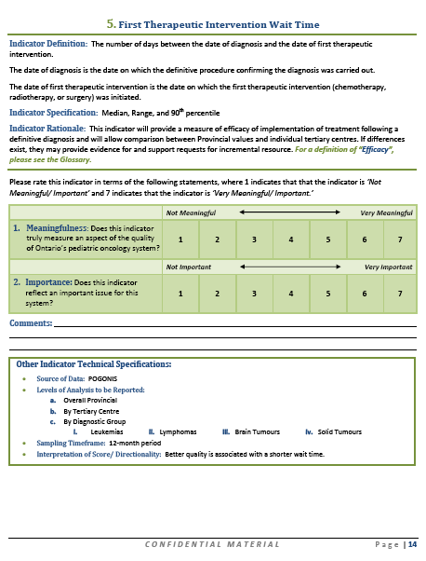
Assessing Stakeholder Agreement Delphi Panel Mailed Survey
Overall survey response rate of 96% (22 of 23 panel members)
Each panel member scored each of the 33 proposed quality indicators on the following two criteria, using a 7-point Likert scale:
Meaningfulness: Does this indicator truly measure an aspect of the quality of Ontario’s pediatric oncology system?
Importance: Does this indicator reflect an important issue for this system?

Slide 34
Assessing Stakeholder Agreement Delphi Panel Survey Results (Degree of Meaningfulness/ Importance by Level of Panel Agreement)
Degree of Meaningfulness/ Importance¹ | Total Quality Indicators (QIs) N (%) | High Agreement (≥70%) | Moderate Agreement (≥60% to <70%) | Low Agreement (≥50% to <60%)
i) Both Very Meaningful and Very Important | 19 (58%) | 10 (53%) | 8 (42%) | 1 (5%)
ii) Either Very Meaningful or Very Important | 6 (18%) | 0 (0%) | 1 (17%) | 5 (83%)
iii) Neutral for both Meaningfulness and Importance | 8 (24%) | 4 (50%) | 2 (25%) | 2 (25%)
iv) Neither Meaningful nor Important | 0 (0%) | 0 (0%) | 0 (0%) | 0 (0%)
TOTAL | 33 | 14 (42%) | 11 (33%) | 8 (24%)
¹ Based on median indicator scores, where the range of median scores across the 33 proposed quality indicators was 4.5 to 7 (i.e. Neutral to Very Meaningful/ Important)

Slide 35
Assessing Stakeholder Agreement Delphi Panel Survey Results (Qualitative)
Some panel members provided feedback on specific indicators e.g. Comprehensiveness of Indicator Construct
this indicator will not measure all components of a particular construct and is not comprehensive
e.g. “Interlink nurses are not the only provider of palliative care.” (Patients Referred for Interlink Care during End-of-Life Care)
Some panel comments necessitate clarification of the charge to the panel: e.g.
this indicator construct is not a significant issue at my centre
my centre would not score well on this indicator/variation across centres
Notes:
MLG Notes on “Indicator Specifications” (based on Email from June 7, 2011 – with added comments from NB/ PR)
Age range variation
due to completeness of data capture for ages 0 to 14 at population-level; we do not have anything approaching complete capture for age range 15-19.
We are aware that participant hospitals accept patients up to 18 years of age, depending on bed availability, but representativeness of the >14 year population is erratic.
We went with standard reported quintiles for age range specifications
Treatment-Related Mortality
We used ALL on the basis of the volume of cases, and a definition that at least was being used in some studies. There could be an argument to go with a higher risk disease but the volumes would be low. (NOTE: Based on correspondence with Lillian Sung).

Slide 36
Stages of Study Development
Phase I Framework Review
Development of Initial Set of Pediatric Oncology-Specific Quality Indicators of System (Investigator Focus Group Sessions)
Evaluation & Selection of a Subset of Indicators based on Sequential Selection Criteria (Indicator Evaluation by Content Experts of the Investigator Group)
First Round of Indicator Review & Evaluation by Pediatric Cancer Stakeholder Community (Delphi Panel Mailed Survey)
Additional Successive Rounds of Indicator Discussion & Evaluation by Stakeholders (In-Person Consensus Meeting)
Review of Published Quality Indicators relevant to Childhood Cancer (Systematic Review and Targeted Grey Literature Search)
Review of Quality Assessment Frameworks (Comprehensive Systematic Review of Quality Assessment Frameworks) (Klassen, et al, 2010)
Further Indicator Definition & Specification (Investigator Focus Group Sessions)
Selection of a Quality Framework for the Childhood Cancer System (Investigator Focus Group)
Phase II Indicator Development & Framework Selection
Phase III Modified Delphi Panel Process

Slide 37
Assessing Stakeholder Agreement In-Person Consensus Meeting
Full-day in-person Delphi panel meeting
Multi-round, iterative, consensus-building process to obtain panel feedback and determine stakeholder agreement
anonymous responses for each indicator were provided on individual electronic devices, aggregated and displayed
high-level of endorsement (e.g. ≥80%) informed by indicator implementation intentions, to ensure high-level of stakeholder community buy-in
External facilitator (Queen’s University School of Business)
Notes:
During the in-person consensus meeting, we wanted to obtain a high-level of panel agreement and community buy-in in order to consider a proposed quality indicator as endorsed by the panel. Therefore, this was defined as > 80% of the panel (for the purposes of the meeting).
Electronic Meeting System:
Combines expert facilitation with group decision support system
to enable groups to rapidly accelerate idea generation and consensus building

Slide 38
Assessing Stakeholder Agreement Charge to Delphi Panel Members
Endorsement should be based on the meaningfulness and importance of each indicator
A systems-level perspective should be taken (and not an individual centre or health care provider level)
There is not a specific target number of indicators (high-level of panel agreement is the priority)
Individuals should not consider issues of feasibility and resource implications in the indicator selection process
Notes:
Focus on issues of feasibility and resource implications and systems-level perspective points here.

Slide 39
Proposed Quality Indicators of the Pediatric Oncology System by Delphi Panel Endorsement
Indicators with Panel Endorsement (≥80% panel agreement) (n=20) | Indicators without Panel Endorsement (n=13)
1. Five-Year Overall Relative Survival 2. Five-Year Event-Free Survival 3. Treatment-Related Mortality 4. Clinical Trial Participation 5. First Therapeutic Intervention Wait Time 6. Chemotherapy Admission Delay 8. Drug Availability 11. Wait Time for Ambulatory Procedures Requiring Anesthesia 12. Access to PET Scanning 13. Pathology Report Turnaround Time 14. Adolescent Cancer Diagnosis within a Pediatric Centre 17. Eligible Survivors Enrolled in AfterCare 18. Survivors with a Survivor Care Plan 22. Case Coordinator 23. Sufficient Multidisciplinary Staff 26. Supportive Care Guidelines 27. Access to Expert Pain Management 29. Potential Drug & Dose Errors (i.e. Near Misses) 30. Actual Drug and Dose Errors 33. Parent/ Guardian Satisfaction | 7. Certification for Nursing Staff for Chemotherapy 9. Use of Conformal or Intensity-Modulated RT 10. After Hours Cancer Surgery 15. Eligible Patients Enrolled in Satellite Care for Chemotherapy 16. Shuttle Sheet 19. Patients Referred for End-of-Life Interlink Care 20. End-of-Life Care Days Spent in Acute Care 21. Guidelines for Nutritional Support 24. Interdisciplinary Team Meetings 25. Tumour Boards 28. ICU Admissions due to Neutropenic Sepsis 31. Central Venous Line Infection Rates 32. Major Clinical Trial Protocol Violation

Slide 40
QIs span the childhood cancer continuum of care
Diagnosis (n=4)
Treatment & Outcome (n=15)
Survivorship (n=2)
End-of-Life Care (n=2)
Safe (n=2)
QIs span the 7 CSQI Quality Dimensions
Effective (n=5)
Responsive (n=1)
Integrated
(n=3)
Accessible
(n=7)
Equitable
(n=2)
Efficient
(n=5)

Slide 41
Outline
Why do this anyway?
Phase I – Quality Assessment Frameworks
Phase II – Quality Indicator Development & Framework Selection
Phase III – Stakeholder Feedback: Modified Delphi Panel Process
Next Steps & Implementation

Slide 42
Accountabilities QI Data Collection, Analyses, Interpretation & Potential Recommendations in Relation to POGO POSQI Oversight Mechanism
2. Data Collection
(Hospitals)
3. QI Analyses, Interpretation & Draft Recommendations (where appropriate)
(Executive/Operational Committee)
4. Review & Feedback of QI Analyses, Interpretation & Draft Recommendations
(External Advisory Committee)
1. Gap Analyses, Hospital Impact Assessments, & Standardization of Data Collection/ Flow to POGO (Technical Working Group)
5. Updated QI Analyses, Interpretation
& Recommendations
(Executive/Operational Committee)
POGO Board
Final Approved QI Analyses, Interpretation & Recommendations
Notes:
Note: Page 12 of circulated SOPs
Accountabilities:
An External Advisory Committee (EAC) and Technical Working Group will provide consultation and expert opinion on technical, data collection, methodological, operational and clinical practice issues to the Executive/ Operational QI (EOQI) Committee .
The EOQI Committee will conduct QI analyses and interpretation and will receive recommendations from the External Advisory Committee (EAC).
The EOQI Committee and EAC are responsible for identifying potential childhood cancer care delivery system and policy-level areas and opportunities for action.
The POGO Board of Directors will review the final QI report and proposed recommendations for possible actions arising from the QI analyses and approve strategies for dealing with such recommendations.

Slide 43
Oversight Mechanism:
External Advisory Committee
Composition:
4-5 representatives from diverse backgrounds, each with a high-level of knowledge of childhood cancer care delivery, health care system planning, and/or QI development/reporting
optimal recruits might be:
childhood cancer experts from other jurisdictions in Canada/Internationally (excluding USA, due to differences in health care systems)
health system planners/researchers/leaders, with experience in QI development/reporting methodologies, pediatric oncology, and/or pediatrics
other stakeholders (parents/survivors of childhood cancer)
Notes:
*** see page 13 of SOPs ***
Feedback from Steini Brown:
First, I think it would be worthwhile thinking about how you pick up on the lessons of the CQCO with the group you are going to convene.
This means that you would have the group also validate and bless annual reports and likely help you put classifications of overall performance on the indicators.
It also means that you would likely be heavy on cancer experts, have some patients/caregivers, and a few experts.
The quasi-independent nature of the group was also useful at times.
You have likely already seen it but you may want to think about looking at the following paper on CQCO: http://www.longwoods.com/content/23162

Slide 44
Next Steps
All quality indicators, endorsed by the Delphi Panel, are undergoing further rigorous review and specification by POGO prior to implementation
Benchmark strategies will be selected for each indicator
Senior Hospital Executives including CEOs are further approached to ensure buy in
A phased approach to indicator implementation in Ontario is envisioned over a three- to five-year period
indicators with established data collection will be reported first
baseline data will be established over three year period
prior to public release, data will be reviewed internally at POGO, followed by consultation with hospitals and further analyses will be conducted (if required)

Slide 45
Potential National Collaboration
Indications of interest from multiple jurisdictions in Canada and internationally
To our knowledge, no existing set of quality indicators for a childhood cancer system in any jurisdiction
Applicability of the indicator set to other jurisdictions:
the majority of indicators represent areas of childhood cancer system quality that could be applicable inter-jurisdictionally
local contexts should be assessed to determine which indicators apply to the local healthcare system
a subset of indicators from the current set may be measured, while additional indicators may be added that are specific to the local healthcare system
Notes:
Canadian interest includes: Atlantic Provinces Pediatric Hematology/Oncology Network (APPHON), Rossy Cancer Network (Quebec), Alberta Health Services (Clinical Quality Metrics Consultant)
International interest includes: Brazil group

Slide 46
Potential for a Common, National Quality Indicator (QI) Dataset
POGO-Developed Childhood Cancer QI Set
Hypothetical QIs Specific
to Other Provinces/ Jurisdictions
QI Subset Specific to Ontario
A Common, National QI Dataset

Slide 47
Investigator Group
Nicole Bradley, MHSc; Healthcare Analyst, POGO
Paula Robinson, MD, MSc; Guideline Methodologist, POGO & C¹⁷ Council
Mark Greenberg, OC, MB, ChB, FRCP(C); Senior Adviser, Policy and Clinical Affairs, POGO; Professor of Pediatrics and Surgery, University of Toronto
Ronald Barr, MB, ChB, MD, FRCP(Glasg) FRCP, FACP, FRCPath, FRCP(C), FRCPCH; Past President, POGO; Professor of Pediatrics, Pathology and Medicine, McMaster Children’s Hospital, Hamilton Health Sciences, McMaster University
Anne Klassen, D. Phil; Associate Professor, Department of Pediatrics, McMaster University
Y. Lilian Chan, PhD; Associate Professor, DeGroote School of Business, McMaster University
Corin Greenberg, PhD; Executive Director, POGO
Supported by CIHR’s Partnerships for Child & Youth Health Indicators
and Ontario’s Ministry of Health and Long-Term Care (MOHLTC)

Slide 48

Thank you!

