Slide 1
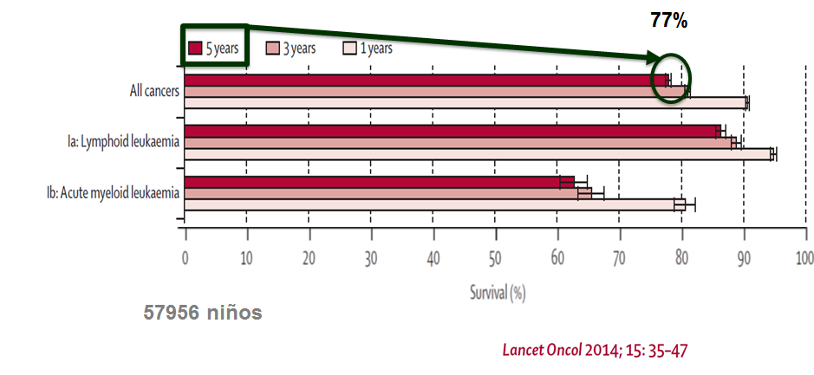




Currently, most children with cancer are cured in affluent countries.
EUROCARE-5
Oscar Ramirez W. MD MPhil
Fundación POHEMA
Centro Médico Imbanaco de Cali
Notes:
El cáncer infantil es curable. Contribuir en cerrar la brecha

Slide 2

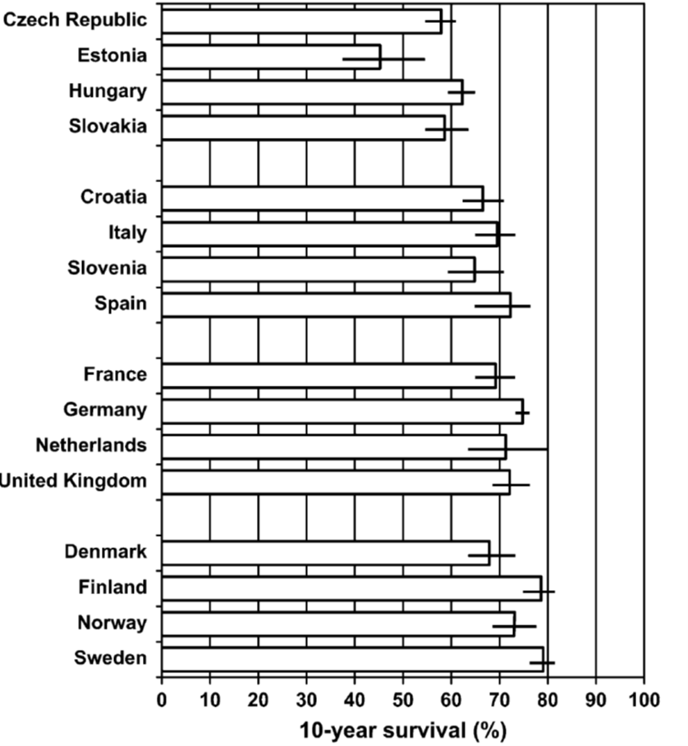

Heterogeneity exists among different countries in childhood cancer survival
Europe
Central America
≤60%
65%
29%
65-80%
Notes:
El cáncer infantil es curable. Contribuir en cerrar la brecha

Slide 3



Clinical outcomes are a consequence of a complex interplay among different biological, behavioral, social, economical, and environmental factors
BIOLOGICAL /
AGENT
CLINICAL/ HOST
TREATMENT
SOCIAL/CULTURAL/ENVIRONMENTAL
Incidence and tumor biology
Advanced tumors
Comorbidities
Host genetics
Health providers skills
Access
Disponibility
Ethics
Health system
Beliefs
Social support
Wealth
Education
Transportation
Others

Slide 4
Poverty
Social support
Education
Cultural beliefs
Health system organization
Diagnosis
Access
Refusal
Delay
Abandonment
Tumoral Biology
Host biology and clinical condition
Treatment: Pertinent & correct intensity
2nd Neoplasm
Progression
Relapse
Supportive therapy
Tumor
Related
Treatment
Related
Other
(non-tumoral related)
Death

Slide 5
Clinical outcomes surveillance is a systematic approach very useful for public health and clinical decision-making. The surveillance can give insights about outcomes current status, about its determinants, and impact of interventions and changes in practice.
Observation and measurement of clinical outcomes
Patient
Advocacy
(NGOs)
Identification of determinants of outcomes
Public health actions
Clinical actions
Continous measurement of impact
Notes:
5

Slide 6
To overview son concepts and results form Cali’s childhood outcomes surveillance system; sponsored by “My Child Matters” program
Notes:
6

Slide 7

VIGICANCER - General Objectives
To carry-out continuous surveillance of clinical results of children and adolescents with a new diagnosis of cancer and treated by pediatric oncology centers in Cali.
To identify biological, clinical and social factors related with these outcomes
To periodically disclose results

Slide 8
An outcomes surveillance system is not:
It is not a conventional cancer registry
  Basic objective is to estimate occurrence risk by time, place person variables
It is no a “classic” public health system
  Surveillance the occurrence of events not outcomes
It is not a hospital registry
It is no a clinical trial
  Imposes changes in classification, treatments or follow-up, to treatment groups. Information dense.

Slide 9
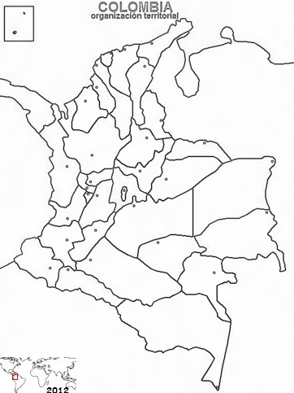
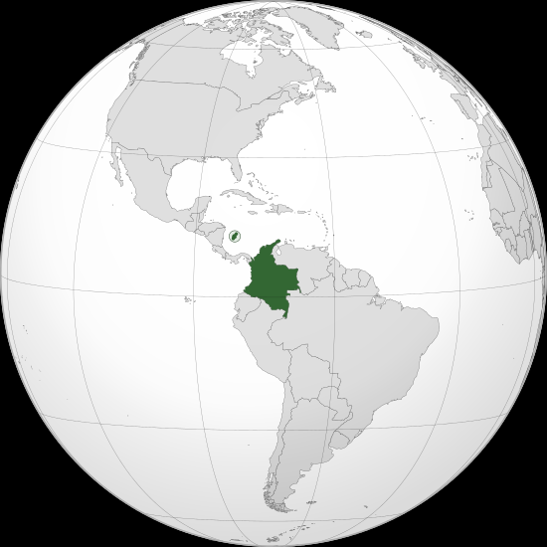
Colombia lies in the northwestern part of South America and is categorized as an upper-middle income and about 47 million inhabitants
Colombia
46.724.86 inhabitants
City of Cali
Valle del Cauca province
4.428.342 inhabitants

Slide 10
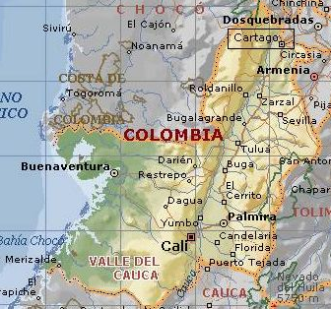

Cali is located in the Valley of the Cauca River, 1070 meters above sea level, with a Gini coefficient of 0.515, 23.1% poverty, and infant mortality rate 11.0 (x 10³ live births)
Cali: 2,232,984 inhabitants (2011)
Cali <15yrs: 550.171
Cali’s Childhood cancer incidence:
141.2 x million pyr (78 new cases/year in Cali)
Total of new diagnosis
in Cali per year: ± 200 children ± 50 adolescents
Notes:
Según el departamento administrativo de planeación de Cali. el número total de habitantes estimado (extrapolado del censo del 2005) para 2009 es de 2.219.633. De estos de 0 a 14 años estimados son: 551.567. De tal forma que si la incidencia de cáncer en <15 años es de alrededor de 141 casos por millon (<15 años). se esperaría 78 casos al
año. Si Cali representa aprox 40% de lo que llega a tratamiento sería 195 casos al año. Vigicancer tenemos 236 casos al año. hasta ahora.
En leucemia linfoblástica aguda si la incidencia es de 40 a 50 casos por millón (<15 años). esperariamos 22 a 27 casos por año.

Slide 11
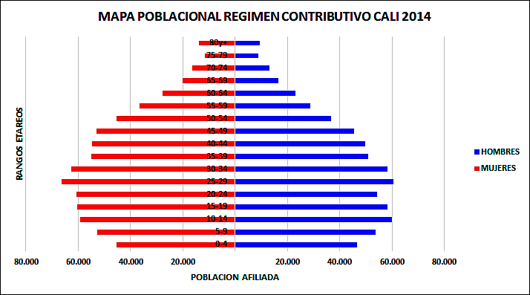
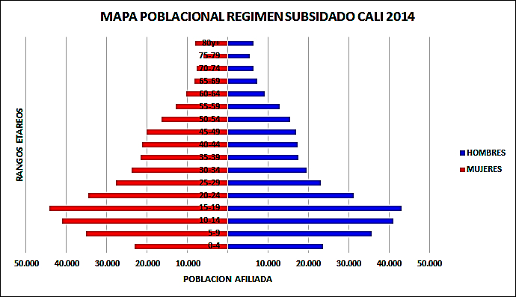
Population demography varies between the main different health plans in urban Cali
Contributory (POSc)
Subsidized (POSs)

Slide 12
Four principles underlies VIGICANCER surveillance system:
Exhaustiveness: ability to represent all children with cancer treated in the city
Timeliness: ability to gather most current data
Simplicity: gather minimum but the most relevant information
Observational: based on routine-care clinical data (real-picture)

Slide 13
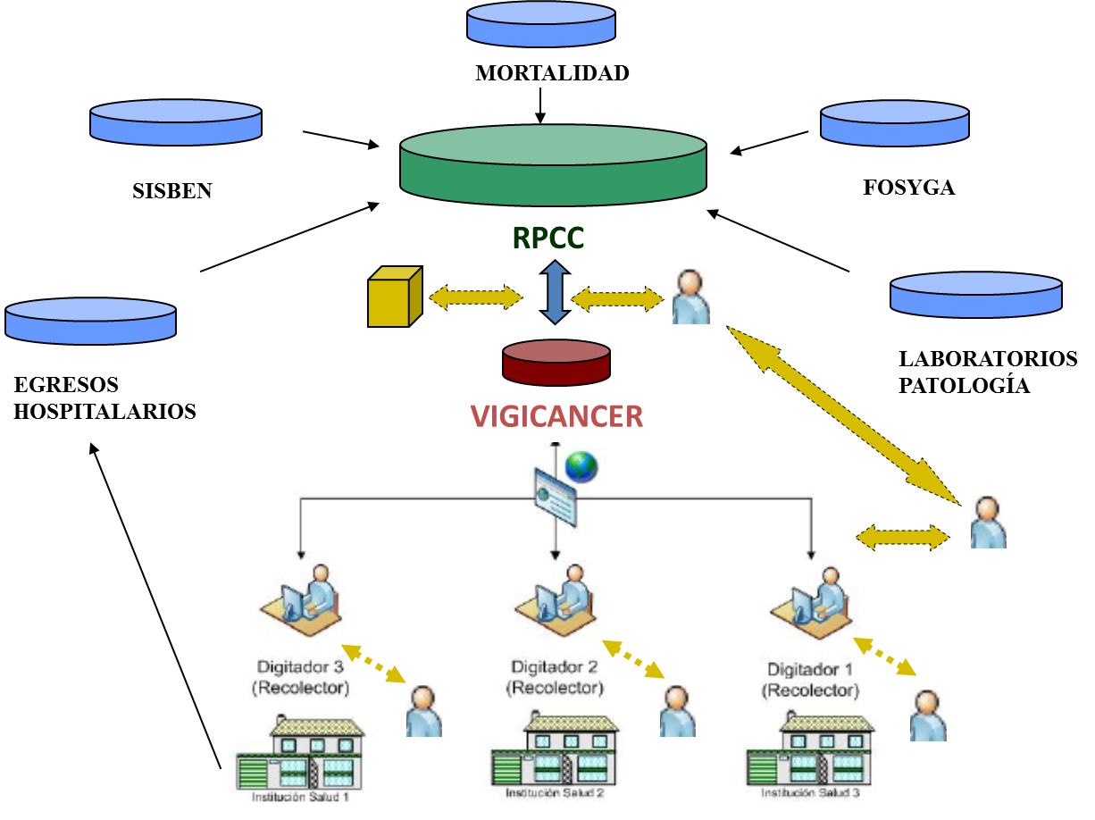
VIGICANCER was designed to be embedded in Cali’s Population-based Registry
13
Notes:
13
13
Use this slide to create a new slide.

Slide 14
System outcomes are:
Primary outcomes
  Death
  Relapse
  Abandoment of treatment
  Secondary neoplasm
Composite outcome
  Event: Death, Relapse or Abandoment of treatment

Slide 15
Since 2009 more than 1000 children have been included in the system with a follow-up of 94%
n = 1221 <15 years
n = 309 ≥15 & <19 years
January/01/2009 to June/30/2015
n = 1530
n = 744 hemato-lymphoid tumors
n = 786 solid tumors
n = 721 contributed to the follow-up
16042.5 months of cumulative time at risk
n = 728 contributed to the follow-up
13123.0 months of cumulative time at risk
n = 239 deaths
n = 249 deaths

Slide 16
About 60% of patients are from outside Cali representing a social/economic problem for families involved
Place of origin | n | %
Cali | 471 | 39
Valle (without Cali) | 424 | 35
Other | 319 | 26
Total | 1214
*Data: <15 years old, Jan/2009 al 30/June/2015
Notes:
16

Slide 17
The ratio of contributory versus subsidized compulsory health plans is almost 1:1.
Health insurance plan |  | n | %
Contributory | (POSc) | 509 | 43
Subsidized | (POSs) | 523 | 44
No insurance coverage | (PPNA) | 66 | 6
Plan for especial groups | (Exception) | 44 | 4
Voluntary private insurance | (Private) | 37 | 3
 | Total | 1179
*Data: <15 years old, Jan/2009 al 30/June/2015
Notes:
17

Slide 18
The distribution of tumors by age is similar to those reported in other countries
ICCC diagnostic group |  | Age | 0-0.9 |  | 1.0-4.9 |  | 5.0-9.9 |  | 10.0-14.9 |  | 15.0-19.9 |  | Total
 |  |  | n | % | n | % | n | % | n | % | n | % | n | %
I. | Leukemias. myeloproliferative diseases. and myelodysplastic diseases |  | 12 | 15 | 163 | 39 | 159 | 46 | 149 | 41 | 90 | 29 | 573 | 38
II. | Lymphomas and reticuloendothelial neoplasms |  | 2 | 2 | 34 | 8 | 40 | 11 | 52 | 14 | 46 | 15 | 174 | 11
III. | CNS and miscellaneous intracranial and intraspinal neoplasms |  | 19 | 23 | 66 | 16 | 67 | 19 | 62 | 17 | 39 | 13 | 253 | 17
IV. | Neuroblastoma and other peripheral nervous cell tumors |  | 10 | 12 | 21 | 5 | 3 | 1 | 2 | 1 | 0 | 0 | 36 | 2
V. | Retinoblastoma |  | 19 | 23 | 42 | 10 | 2 | 1 | 0 | 0 | 0 | 0 | 63 | 4
VI. | Renal tumors |  | 7 | 9 | 40 | 10 | 11 | 3 | 1 | 0 | 1 | 0 | 60 | 4
VII. | Hepatic tumors |  | 6 | 7 | 11 | 3 | 0 | 0 | 4 | 1 | 0 | 0 | 21 | 1
VIII. | Malignant bone tumors |  | 0 | 0 | 3 | 1 | 22 | 6 | 38 | 10 | 45 | 15 | 108 | 7
IX. | Soft tissue and other extraosseous sarcomas |  | 1 | 1 | 21 | 5 | 20 | 6 | 20 | 5 | 15 | 5 | 77 | 5
X. | Germ cell tumors. trophoblastic tumors. and neoplasms of gonads |  | 3 | 4 | 6 | 1 | 14 | 4 | 17 | 5 | 25 | 8 | 65 | 4
XI. | Other malignant epithelial neoplasms and malignant melanomas |  | 1 | 1 | 3 | 1 | 7 | 2 | 14 | 4 | 38 | 12 | 63 | 4
XII. | Other and unspecified malignant neoplasms |  | 2 | 2 | 3 | 1 | 3 | 1 | 8 | 2 | 7 | 2 | 23 | 2
 |  | Total | 82 | 5 | 413 | 27 | 348 | 23 | 367 | 24 | 306 | 20 | 1516

Slide 19

Five year overall survival (OS) of children with cancer in Cali is about 20% below of what is currently expected
77%
5yr-OS = 54% (IC95%: 50, 58) abandonment of treatment censored
5yr-OS = 53% (IC95%: 49, 57) abandonment of treatment as event
57956 niños
19
Notes:
19
19
Use this slide to create a new slide.

Slide 20

As reported by others, adolescents have a worst survival compared to children in Cali
54% (IC95%: 50, 58)
38% (IC95%: 28, 49)
20
Notes:
20
20
Use this slide to create a new slide.

Slide 21
OS for children with cancer by the most frequent ICCC groups; I, II, and III
II: 77% (IC95%: 67, 84)
I: 57% (IC95%: 51, 63)
II: 39% (IC95%: 29, 49)
ICCC group
― I ― II ― III

Slide 22
Health plan assignment seems to discriminate population groups with different survivals
Private: 84% (IC95%: 65, 93)
POSc/Exc: 64% (IC95%: 58, 69)
POSs: 51% (IC95%: 45, 57)
PPNA: 38% (IC95%: 25, 51)

Slide 23
The survival gap is greater when event free survival (EFS) is used as outcome
Private: 81% (IC95%: 63, 91)
POSc/Exc: 60% (IC95%: 55, 65)
POSs: 37% (IC95%: 30,44)
PPNA: 23% (IC95%: 11, 37)

Slide 24
The differences of EFS among health plans are maintained between solid and hematologic/lymphoid tumors. Nevertheless within the subsidized plan no difference is found.
H/L: 64% (IC95%: 57, 71)
POSc/Exc
Solid: 57% (IC95%: 50, 63)
H/L: 41% (IC95%: 34, 48)
POSs
Solid: 38% (IC95%: 30, 46)

Slide 25
Other prognostic factors abrogates the effect of risk classification; here acute lymphoid leukemia as example.
Acute Lymphoid Leukemia EFS by risk category
Low risk
High risk
POSc/Exc: 80% (IC95%: 65, 89)
POSc/Exc: 55% (IC95%: 39, 68)
POSs: 44% (IC95%: 31, 57)
POSs: 27% (IC95%: 13, 43)

Slide 26
The pattern of survival by health plan seems to change depending of the diagnosis group. (EFS, ICCC groups)
II
III
IV
V
VI
VII
VIII
IX

Slide 27
Abandonment of treatment is an important determinant of survival and partially explains the differences in survival among health plans
Cumulative incidence
24 months cumulative incidence of abandoment of treatment
PPNA: 35% (IC95%: 19, 62)
POSs: 22% (IC95%: 17, 28)
POSc/Exc: 4% (IC95%: 2, 7)
Private: 3% (IC95%: 1, 9)

Slide 28
High abandonment of treatment and toxic deaths explains most of the survival gap among health plan in acute lymphoid leukemia.
Abandonment
Toxic mortality
POSs: 29% (IC95%: 20, 41)
POSs: 27% (IC95%: 15, 76)
POSc/Exc: 3% (IC95%: 1, 9)
POSc/Exc: 11% (IC95%: 7, 19)

Slide 29
For Wilms tumor, about 30% in the difference of events among health plan groups can be attributed to abandoment of treatment. Relapse incidence is equal among groups.
Toxic mortality
Abandoment of treatment
Event (death, relapse, abandoment)
35%
33%
5%
POSs: 5% (IC95%: 1, 34)
POSs: 42% (IC95%: 18, 97)
POSs: 66% (IC95%: 35, 99)
POSc/Exc:
POSc/Exc: 9% (IC95%: 14, 69)
POSc/Exc: 31% (IC95%: 14, 69)

Slide 30
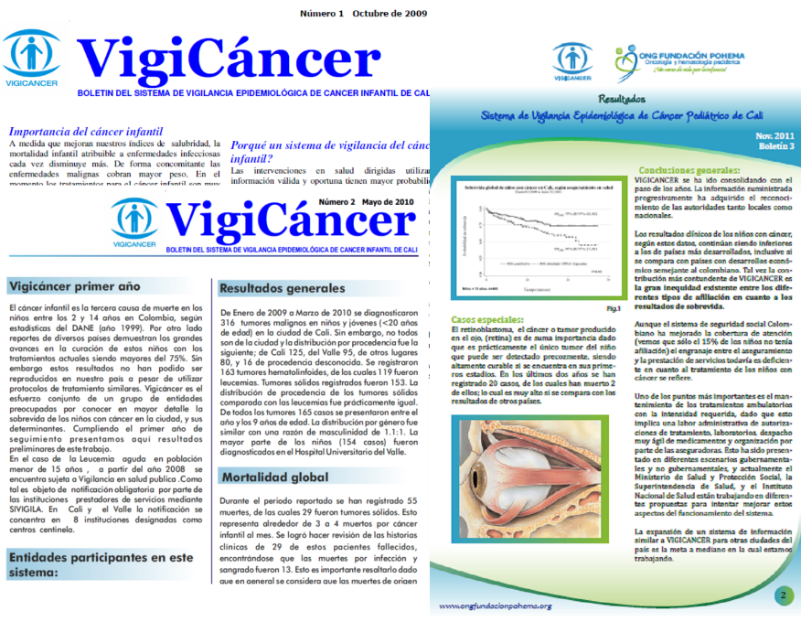
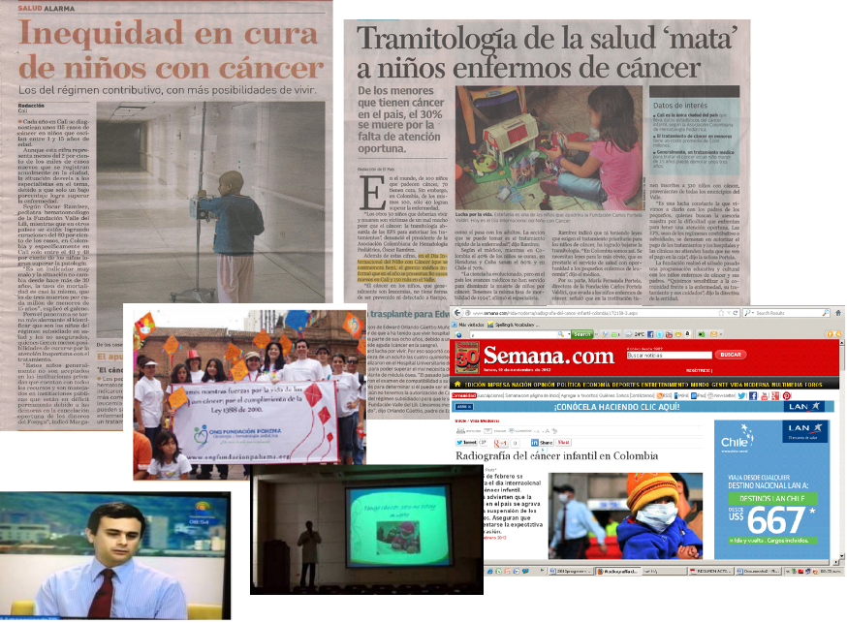
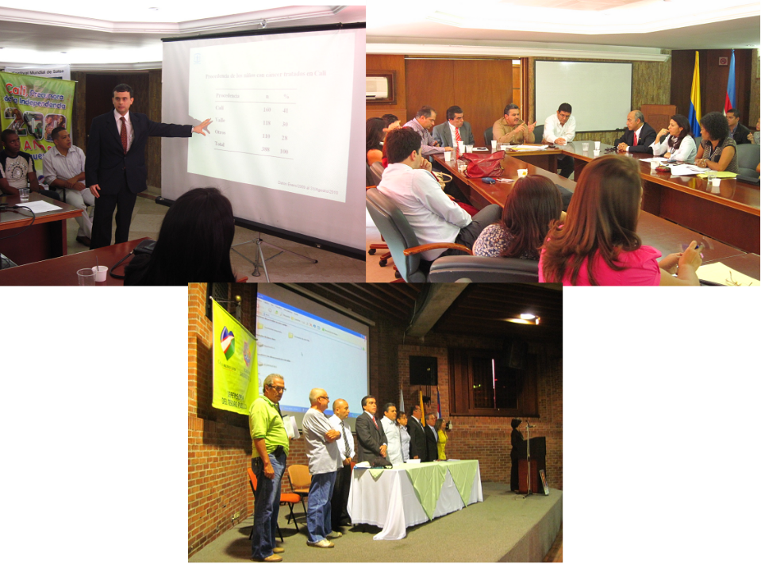
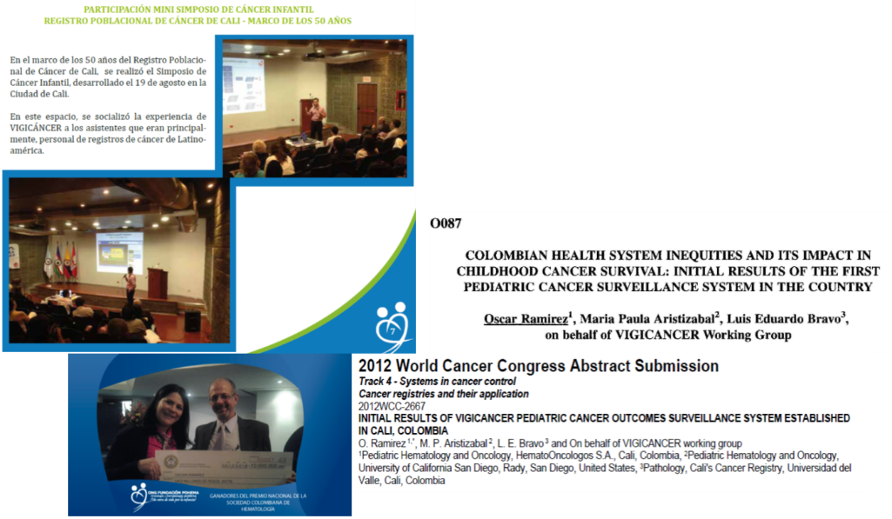
Part of the integral part of the system is to disclose the results to different audiences
30
Notes:
30
30
Use this slide to create a new slide.

Slide 31
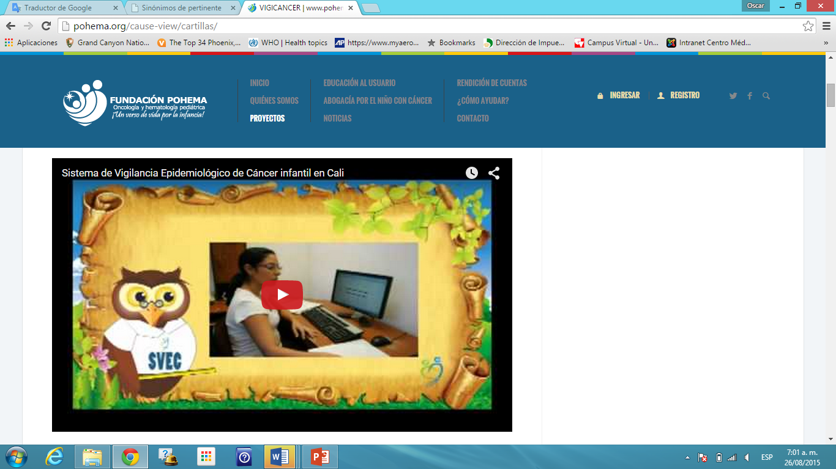
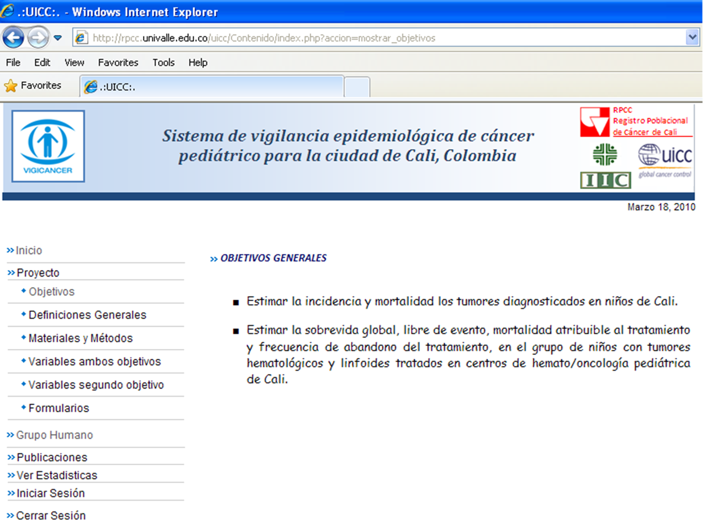
We have used both Cali’s Population-based Cancer Registry and POHEMA’s websites to display information about the system
www.pohema.org
rpcc.univalle.edu.co
Notes:
31

Slide 32


Working group
RPCC
Luis E. Bravo
Luz Stella García
Paola Collazos
Tito Collazos
Mariela Palacios
Juan Carlos Hernández
Julio César Guarnizo
Monitores
Mónica Lotero
Dilia
Asesores
Maria Paula Aristizabal
Eva Steliarova-Foucher
Hemato/Oncólogos Pediatras
Viviana Lotero
Ximena Castro
Margarita Quintero
Diego Medina
Carlos Andrés Portilla
Oscar Ramírez
Patología
Roberto Jaramillo
SPONSOR: UICC-Sanofi-Aventis
“My Child Matters” Program
Notes:
32

